Slide 1
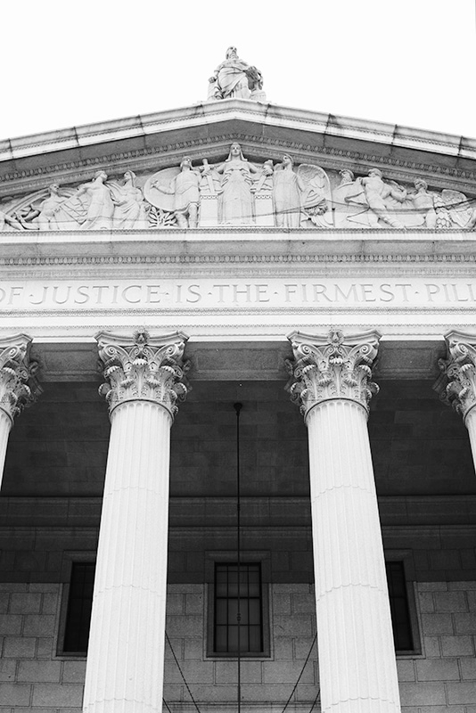
AI Portfolio Allocator
Julian Chang
Reinforcement Learning and Long-term Investment

Slide 2
Table of contents
1
2
3
4
Objective
RL models
Background & Problem Statement
Concepts of Reinforcement Learning
Feature Engineering
Model & Performance
Model Inuputs
Backtest Results and Website

Slide 3
1
Objective
Reinforcement Learning model to solve for long-term investment strategy

Slide 4
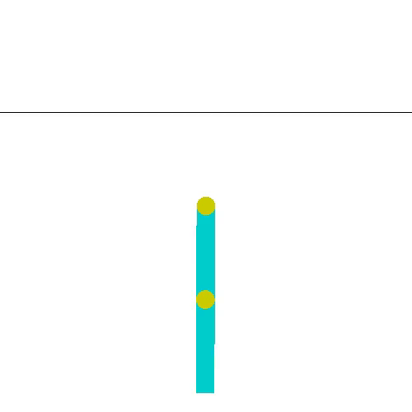
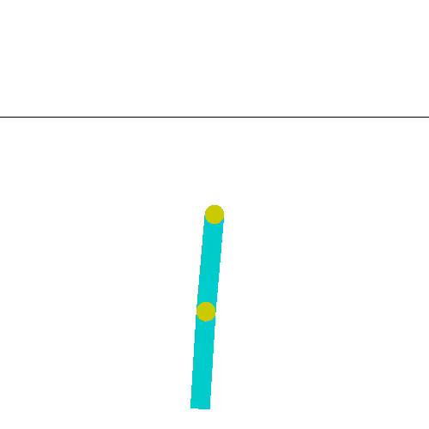
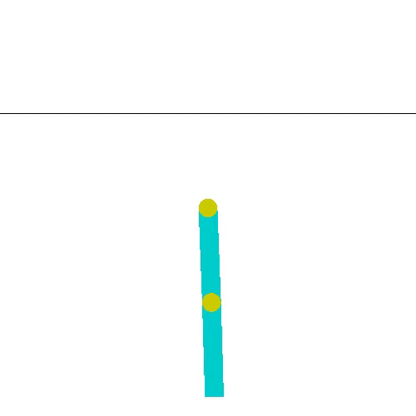
Reinforcement Learning
Reinforcement learning is very cool. I wanted to apply this with investment strategy!
AI Portfolio Allocator

Slide 5

Portfolio Management
Portfolio management involves building and overseeing a selection of investments that will meet the long-term financial goals and risk tolerance of an investor.
- Investopedia
AI Portfolio Allocator

Slide 6
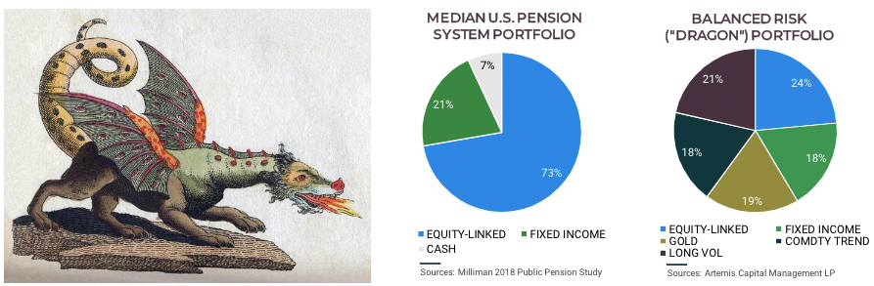
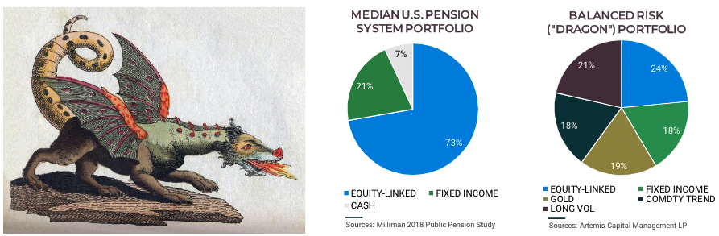
Dragon Portfolio
“The successful 100-year portfolio must be able to navigate … assets that perform during eras of secular change, versus those that perform best during economic stability and growth …”
-THE ALLEGORY OF THE HAWK AND SERPENTHOW TO GROW AND PROTECT WEALTH FOR 100 YEARS (Artemis Capital Management L.P.| January 2020 | All Rights Reserved)
AI Portfolio Allocator

Slide 7
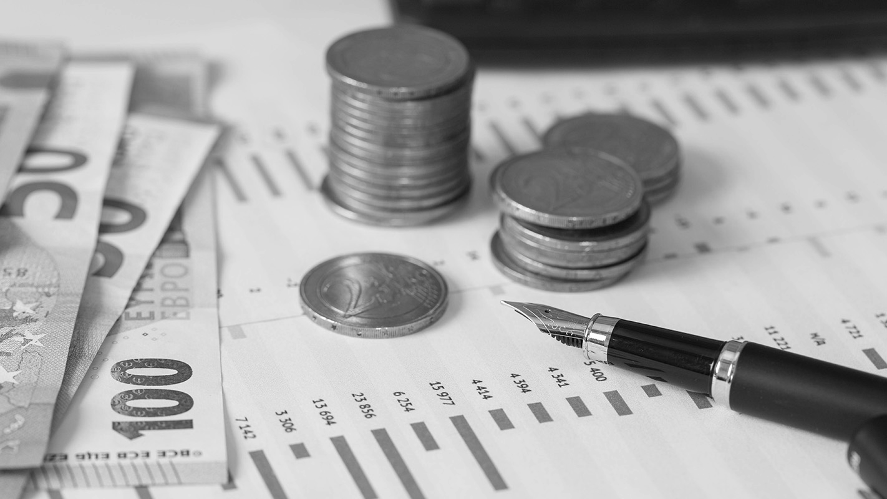
Problem Statement
This project assessed the performance of Deep Reinforcement Learning (RL) in an investment environment. Model performance was compared against the Dragon portfolio in a backtest from 2020 to 2021. Starting with 1 Million in capital
AI Portfolio Allocator

Slide 8
$ 47,000
AI Portfolio Allocator outperformed Dragon Portfolio by
AI Portfolio Allocator

Slide 9
RL Agents
2
Concepts of Reinforcement Learning

Slide 10
Example
State:
raining
sunny
snowing
Environment == weather
Action:
go outside and play
stay home
read an article
Agent == Jane
Reward:
level of your satisfaction (e.g. 5)
AI Portfolio Allocator

Slide 11


Example
Agent will observe state from the Environment. Environment state: cloudy
Agent will choose an action: to go outside. Environment registers that the Agent chose action: to go outside
Environment will tell the Agent: reward (level of satisfaction), the Agent will receive reward e.g. very satisfied.
AI Portfolio Allocator

Slide 12
Feature Engineering
3
Model inputs
AI Portfolio Allocator

Slide 13
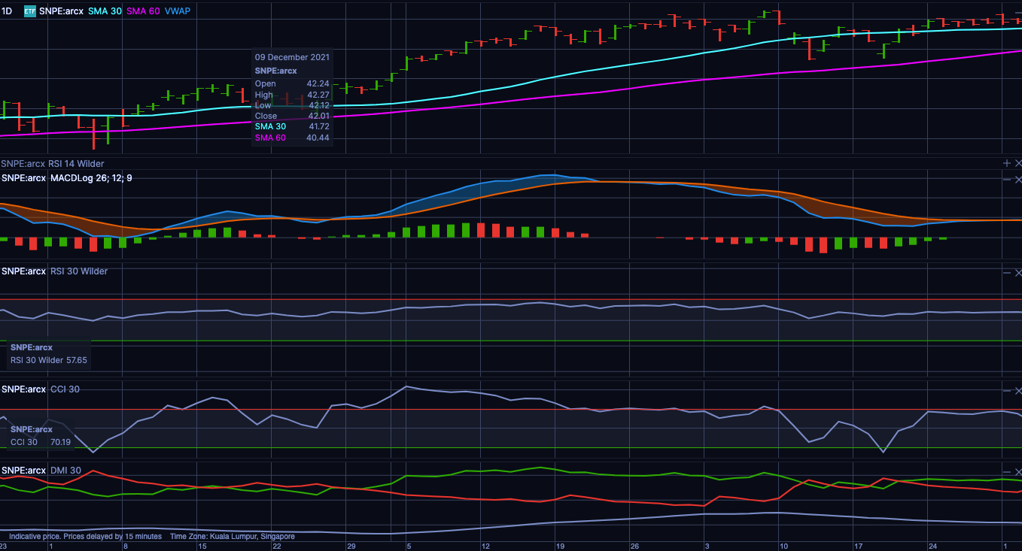
State – Price, Indicators
Close & SMA
MACD
RSI
CCI
DX
AI Portfolio Allocator

Slide 14
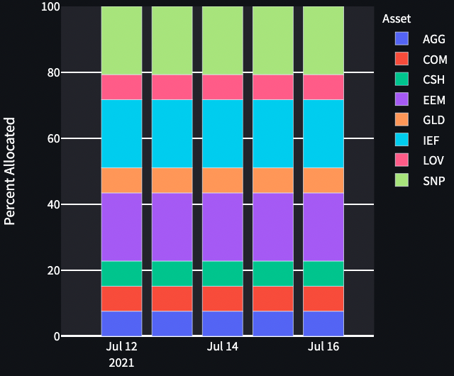
Actions
Portfolio Allocation is just the combination of all investments with a given level of capital
Sum of allocations adds to one
AI Portfolio Allocator

Slide 15
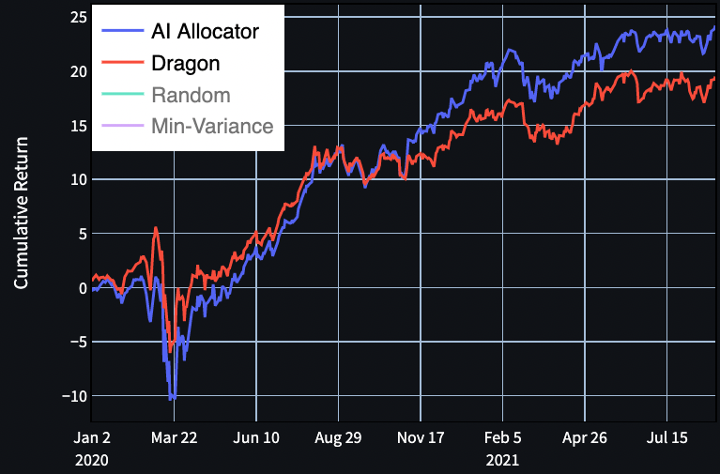
Reward
The daily percentage outperformance of the Dragon portfolio is the reward
AI Portfolio Allocator

Slide 16
Model & Performance
4
Model implementation and results
AI Portfolio Allocator

Slide 17
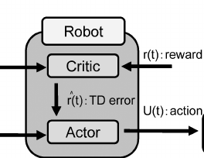

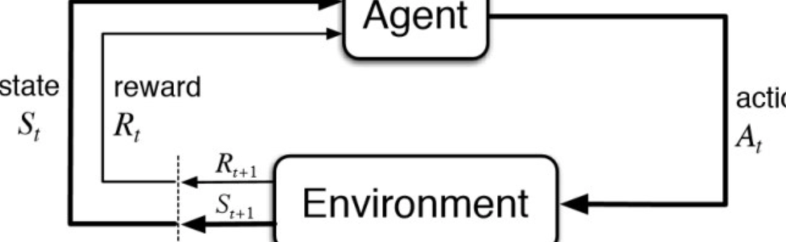
Model Training
Agent
Return at time t
State at time t
Action at time t
?
?
Actor
Critic
AI Portfolio Allocator

Slide 18

Model Training
Agent
Return at time t
State at time t
Action at time t
Actor
Critic
Entropy
AI Portfolio Allocator

Slide 19
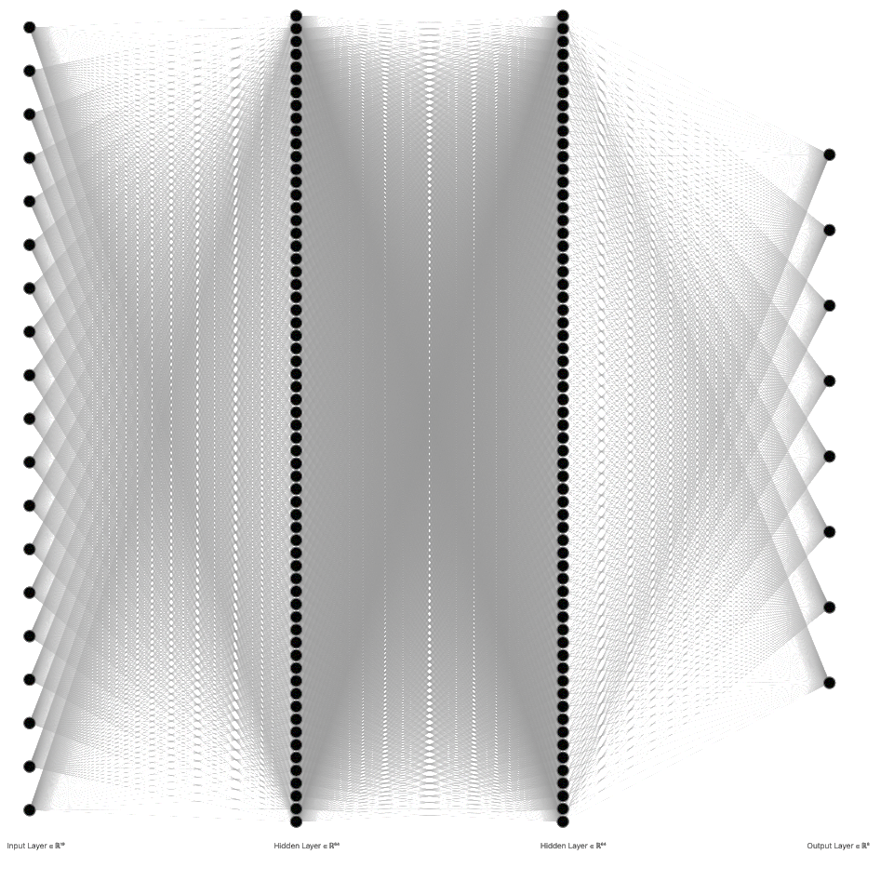
Neural Networks
Output Layer, 8
Input Layer, 19
Hidden Layer, 64x64
or
Output Layer, 1
AI Portfolio Allocator

Slide 20
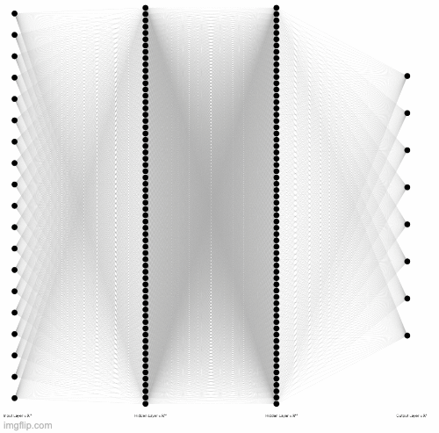
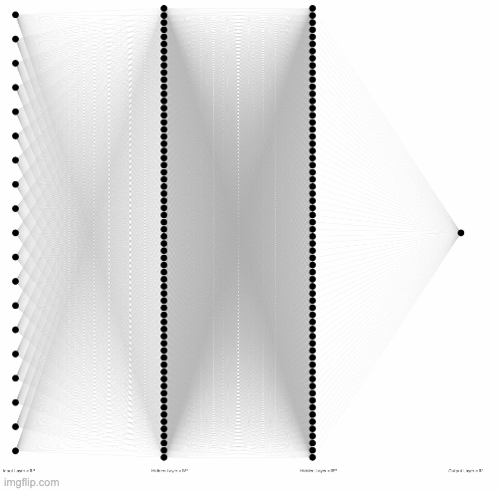
Neural Networks
AI Portfolio Allocator

Slide 21
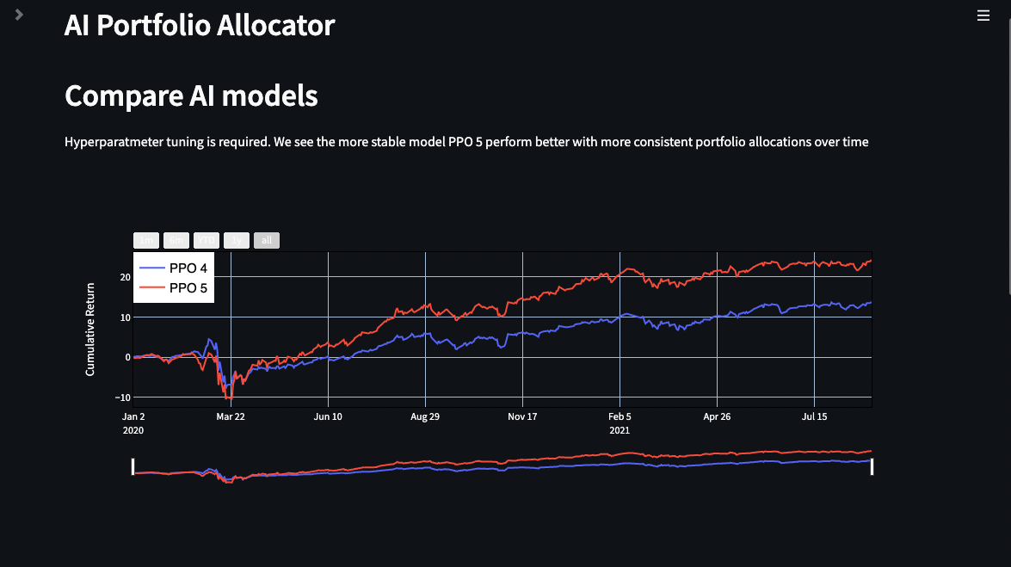
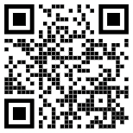
Desktop web
Check out my backtest results at my webapp!
ai-portfolio-allocator.herokuapp.com/
AI Portfolio Allocator

Slide 22
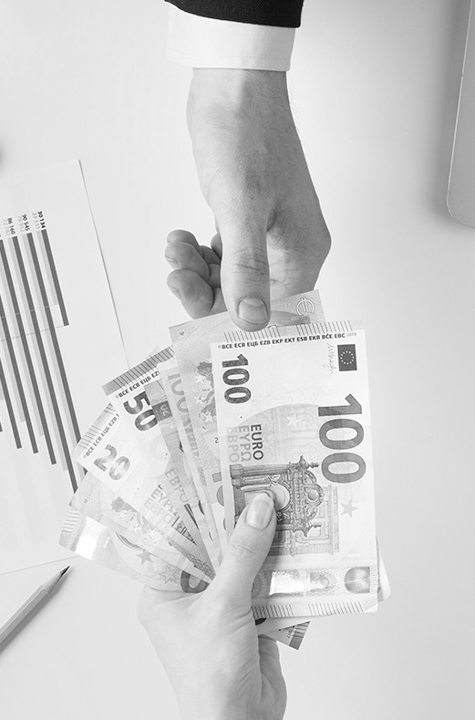

Thanks!
Do you have any questions?
changjulian17@yahoo.com
/in/julian-chang/
/changjulian17
ai-portfolio-allocator.herokuapp.com
Please keep this slide for attribution
AI Portfolio Allocator

Slide 23
More on this project
Here’s an assortment of links to write-ups I’ve done for this project
AI Portfolio Allocator - Website
Medium Article on PPO model
Medium Article on model parameters
Medium Article on State, Action, Reward and Policy Gradient
Top view finances elements arrangement
Tensorboard of PPO 4 and PPO 5
Github Repository
AI Portfolio Allocator

Slide 24
AI Portfolio Allocator
Background
Long term investing for 100 years of inter-generational wealth. E.g. covid shock.
New methods of developing a strategy. One that adapts with current conditions but has memory as far back as necessary
RL and Macro Investing my two new interests
Problem statement
Problem statement
Constraints
RL program
Example of RL
PPO as a solution
Preprocessing
Features used
Indicators
Dynamic action space
Trained model
Backtest results
Minv
Random
Dragon ***
AI models
Current model vs older models
website
AI Portfolio Allocator

Slide 25
Constraints
Dividends
Transaction fees
Not included
Free trades
5 Assets
Equities, Fixed Income, Gold, Commodities, Long Voilatility
PPO
Date Range
Model-free, on-policy, Actor-critic network model
2004-12-01 to 2021-9-01
AI Portfolio Allocator

Slide 26
RL model
Environment
Agent
AI Portfolio Allocator

Slide 27
RL model
Environment
Action at time t
Agent
Reward at time t+1
Reward at time t
State at time t+1
State at time t
AI Portfolio Allocator

Slide 28
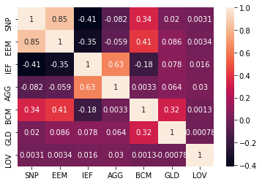
State – Covariance Matrix
Example Correlation Matrix
AI Portfolio Allocator

Slide 29
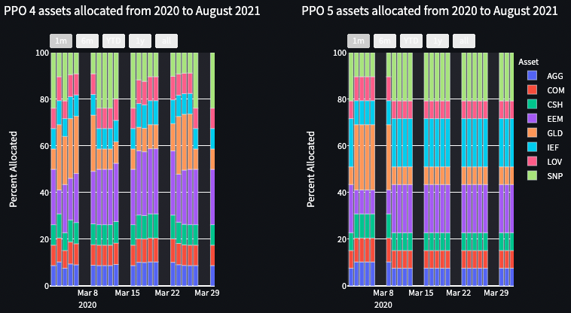
Underfit models
, March 2020
, March 2020
Model PPO 4 trained for 5 hours and Model PPO 5 trained for 7 hours.
Longer training periods lead to stable allocations and better returns
AI Portfolio Allocator

Slide 30
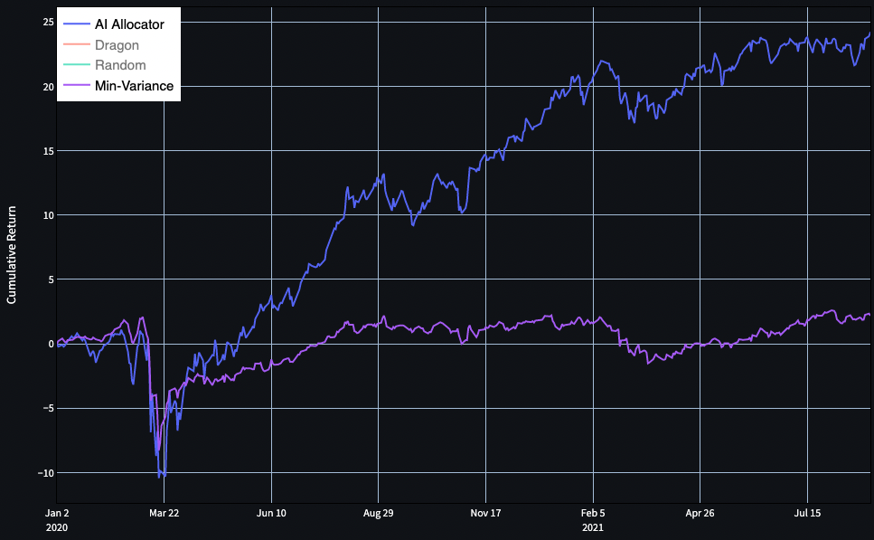
Model Performance
Another Investment baseline is the Minimum Variance portfolio, which least risky
AI Portfolio Allocator

Slide 31
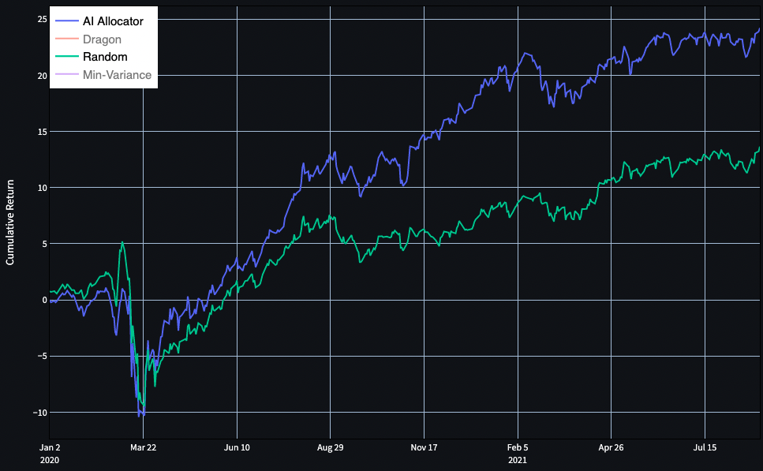
Model Performance
A common RL baseline is a Random Agent with a 11 to 13 +/- 3% Annual return in this backtest
Poorly trained PPO models have similar or worse return
Final model has greater expected returns and lower variance
AI Portfolio Allocator

Slide 32
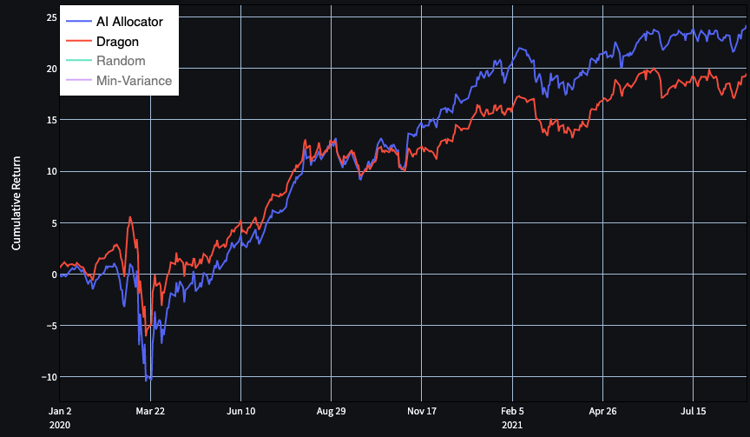
PPO Model had 4.7% outperformance over Dragon Portfolio
2020 to 2021 Aug

Slide 33
Backtest Comparisons
 | PPO | Dragon | Min-Var | Random
Annual Return (% p.a.) | 13.9 | 11.3 | 1.3 | 10.3
Cumulative Return (%) | 24.2 | 19.5 | 2.2 | 19.5
Annual Volitility (%) | 12.0 | 9.9 | 5.7 | 10.3
Sharpe Ratio | 1.15 | 1.13 | 0.26 | 1.00
AI Portfolio Allocator

